Slide 1
The PhenoDB
Quick overview

Slide 2
Overview of the COVID-CNS database
Main features
Flexible: One or multiple cohorts/projects. Keep individual identifiable data at a separate location or use the database to enforce separation from safer data.
Simple (relatively): Multiple instances*. Branch and use for new projects easily. Add your features.
Cohort data: Store typical cohort research data in a consistent way, including questionnaire data and IDPs. Instruments are used consistently across study stages/timepoints.
Metadata: Relational database of metadata and annotations of cohort research data; instrument types, instruments, items and variables etc.
Cohort summary data: Variable statistics, phenotype cohort prevalences.
Summary data: GWAS sumstats, population phenotype prevalences, meta-analysis cohort overlaps.

Slide 3
Overview of the COVID-CNS database
Secure access levels - roles
Owner | full access | Ex. Ian, Johan, anyone helping administrate the database
Co-worker | can read/write all data in the database, including protected data | Ex. Zain, anyone who would edit and/or import new data, access secure data, link original ID’s
User | can read non-protected data and write to designated areas (user’s own schema) | An ‘extractor’ role for a group.
Reader | can read metadata only | Anyone who would like to view metadata and data dictionary type or aggregated data views.

Slide 4

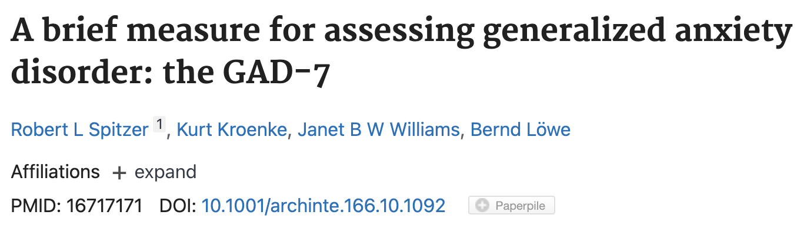


Overview of the COVID-CNS database
Metadata entities, examples
Cohort
Assessment
Assessment Item
COVID-CNS DEM1
“Which hand do you usually write with?”
Over the past 2 weeks, how often have you been bothered by the following problems? Select ONE for each of the following statements:
Oxford server/UK Biobank type IDP collection
COVID-CNS Cognitron assessment
Target Detection

Slide 5
Overview of the COVID-CNS database
All entities and data
COVID-CNS Relational Database
Metadata
Dataset
Cohort
Summary
Cohort
Protected
Instance
Stage
Assessment
Literature reference
Phenotype
Country
Summary/cohort/protected type
Other cross-cohort data
Cognitron
GWAS summary statistics
Questionnaire
Population prevalence
Individual
Individual identifier – cohort
MRI
Other sensitive data
Item
Type
Variable

Slide 6
Overview of the COVID-CNS database
Cohort data storage
A table per cohort, cohortinstance, assessment, assessment version and table index Tables are indexed from 1 and up to accommodate large collections of variables, such as IDP’s
Table name convention: [cohort]_[cohortinstance]_[assessment]_[assessment version]_[table index]
Table column name convention: [item]_[variable]
_id | _stage | _individual_identifier | _time_entry | item1_var1 | item1_var2 | Item2_var1
1 | bl | 384a094d-0918-c14d-8b3a-c89caa6cc847 | 2023-02-08 16:59:34.637 +0000 | 1 | “Some text entry” | 0
2 | bl | 384a094d-0918-c14d-8b3a-c89caa6cc847 | 2023-02-13 09:39:38.256 +0000 | 1 | “Some new text entry” | 1
3 | t1 | 384a094d-0918-c14d-8b3a-c89caa6cc847 | 2023-02-08 16:59:34.637 +0000 | 1 |  | 1
4 | t2 | 204a014b-9261-a21c-2c3b-b51cdd3cc762 | 2023-02-08 16:59:34.637 +0000 | 2 | “Some other text entry” | 1

Slide 7

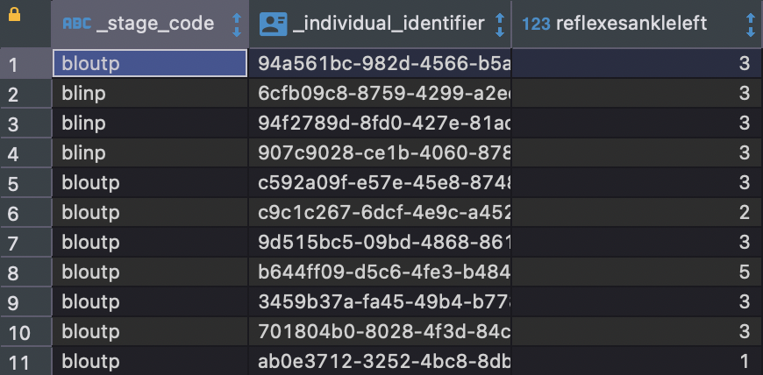
Overview of the COVID-CNS database
Simplifying the structure using stage
COVID-CNS Clinical neurological assessment

Slide 8
Project code repositories and online documentation
https://github.com/tnggroup/gwas-phenotype-database-4-pgsql
https://github.com/tnggroup/phenodbr

Slide 9
Thank you!
For inquiries to have direct access to the database:
For anything else:
covidcns@liverpool.ac.uk
johan.kallberg_zvrskovec@kcl.ac.uk

